Slide 1

Azure Runbook
Azure Runbooks are a powerful tool that can help you automate many of the tasks that you do in Azure. They can save you time and money, and they can help you to reduce errors.
the RunAs account has been deprecated. Instead, utilize the -Identity parameter in PowerShell to assign the 'System Security' user with the Contributor role.

Slide 2
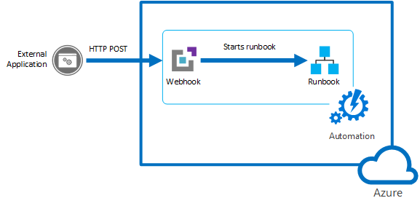
Webhooks and Runbooks in Azure Automation
Webhook URL can be called from on prem system/any custom apps
1. A webhook allows you to start a runbook in Azure Automation through a single HTTP request.
2. This allows external services such as Visual Studio Team Services, GitHub, or custom applications to start runbooks without implementing a full solution.
3. A webhook can define values for runbook parameters that are used when the runbook is started by that webhook.
4. Multiple webhooks linked to a single runbook can each use different parameter values.
5. Each webhook has an expiration date at which time it can no longer be used.

Slide 3

Authentication of Webhook Requests by the Runbook
1. The security of a webhook relies on the privacy of its URL which contains a security token that allows it to be invoked.
2. Azure Automation does not perform any authentication on the request as long as it is made to the correct URL.
3. For this reason, webhooks should not be used for runbooks that perform highly sensitive functions without using an alternate means of validating the request.
4. You can include logic within the runbook to determine that it was called by a web hook by checking the WebhookName property of the $WebhookData parameter.

Slide 4
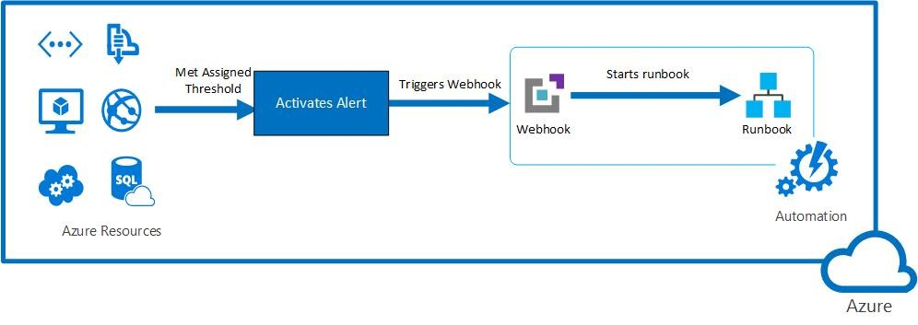
Starting runbooks in response to Azure alerts
1. Webhooks can be used to react to Azure alerts.
2. Resources in Azure can be monitored by collecting statistics like performance, availability and usage.
3. You can receive an alert based on monitoring metrics or events for your Azure resources.
4. When the value of a specified metric exceeds the threshold, a notification is sent to the service.
5. Besides using alert system, you can also kick off runbooks in response to alerts.
6. Webhooks allows you to start a runbook from the command line using the Webhook button.

Slide 5
Summary
Action Items:
Runbooks: Runbooks are powerful tools that can automate many of the tasks that you do in Azure.
Webhooks: Webhooks are a way for external services to start Azure Automation runbooks. They are made up of a unique URL and a security token. The URL is the address that the external service calls to start the runbook, and the token is used to authenticate the call.
Security: Webhook URLs are sensitive and should be treated as passwords. You should only share them with trusted services. Additionally, webhook tokens have expiration dates, so you need to make sure that you update your runbooks and external services accordingly.
Secure your webhook URLs: Treat your webhook URLs like passwords and only share them with trusted services.
Monitor your webhook expiration dates: Set up alerts to notify you when your webhook tokens are about to expire.
Update your runbooks and external services: When a webhook token expires, you need to update your runbooks and external services to use the new token

